Slide 1
Typescript
What is TypeScript
Objects
Classes
Constructor
This

Slide 2
TypeScript
TypeScript is an open source programming language developed and maintained by Microsoft.
It is a strict superset of JavaScript
Unlike JavaScript which is a scripting language TypeScript is a compiled language where the output is JavaScript.
This compilation process allows for static type checking (the type of a variable is known at compile time) that dynamically typed languages like JavaScript can not do.

Slide 3
Objects Review
We can assign objects to variables in JavaScript:
var person = {
name: “Jack”,
age: 20
};
We can access the properties of an object using dot notation:
person.name = ‘Jill’;
person.age = 21;
console.log(person.name + ‘ is ‘ + person.age + ‘ years old’);

Slide 4
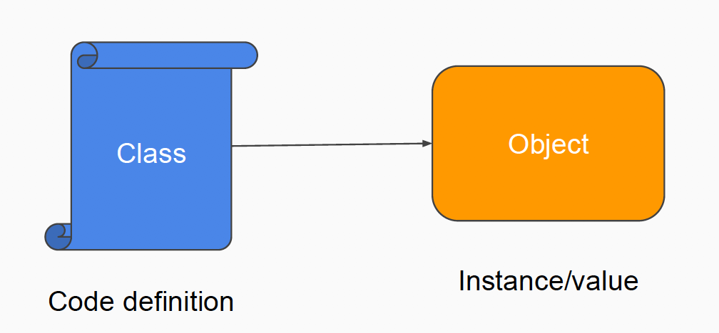
Classes
What is the type of an object?
In JavaScript, objects previously didn’t have types.
In TypeScript the type of an object is generally specified using a class JavaScript has added support for classes in ES6(Ecmascript) (now supported by all browsers)

Slide 5
Classes
A class is a description of what should go in an object
It defines the structure of an object
An object can then be created that conforms to the class description
We create a class using the class keyword:
Class names typically start with an uppercase character
We can add properties to classes (but note that var or let are not used):
class Person {
}
class Person {
name: string;
age: number;
}

Slide 6
Variable with a class type
Remember that a class defines the type for objects
So we can now declare a variable with the class Person type:
var person: Person;
The lowercase person is the variable name, and the uppercase Person is
the type of the variable (defined by the class Person)

Slide 7
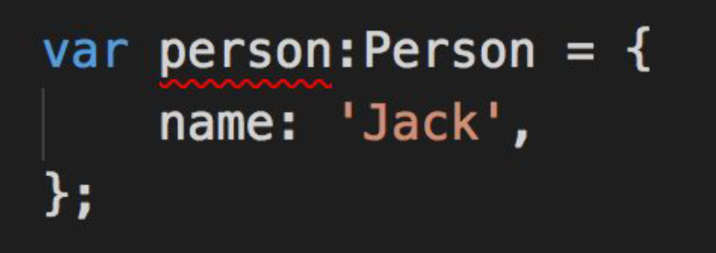
Assigning an object to a variable with class type
We can assign an object directly to person:
person = {
name: ‘Jack’,
age: 20
};
Note: that the fields (name and age) are the same, if we skip a field we get an error because the variable no-longer follows the “shape” of the class.

Slide 8
Creating a new instance of a class
Instead of ensuring that we have all of the fields correct, we can use the
new operator (similar to new Array())
This creates a new object with properties in the class but with no values:
var person = new Person();
We can then assign values to the person using object dot notation:
person.name = ‘Jill’;
person.age = 21;

Slide 9
Constructors
Constructors are functions which run when an object is created from the
Class via the new keyword.
Constructors are usually used to initialise values in the newly created object
A constructor must be called constructor
class Person{
name: string;
age: number;
constructor(){
this.name = “todd”;
this.age = 22;
}
}
var person: Person = new Person();
console.log(‘Hello “ + person.name);
constructor is a function defined inside the class
The keyword function is not used
A constructor has no return type or return value

Slide 10
this
In the previous example this appears ( this.name = “todd”; )
If we don’t use "this" the compiler thinks the name and age variables are not
declared
When we want to access class variables from within the class we must
use this in front of them
this simply means the current object, so we are accessing the variables of
the current object (as opposed to variables declared inside the function or
globally)

Slide 11
Constructor Parameters
We can declare parameters for the constructor function
Constructor parameters allow us to pass in values to the constructor
e.g. to use as the initial values
class Person{
name: string;
age: number;
constructor(name: string, age: number){
this.name=name;
this.age=age;
}
}
var person: Person = new Person(“Jill”,23);
console.log(‘Hello “ + person.name);
constructor parameters
variables without this are either local or global variables,
but not class variables (parameters are local variables)

Slide 12
Default Parameter Values
We can give parameters default values
This makes those parameters optional
If a value is not provided for that parameter it will use the default value
class Person{
name:string;
age:number;
constructor(name:string, age:number = 18){
this.name=name;
this.age=age;
}
}
var person:Person = new Person(“Jill”);
console.log(‘Hello “ + person.name + “ is ” + person.age);
default parameters value
We are not required to provide a value for the parameter

Slide 13
Declaring properties with constructor parameters
TypeScript allows us to declare properties in constructor parameters
● This can reduce the number of lines in a class, and saves us typing the
variables twice
● The following example is identical to the previous except that it declares
properties in the parameters
● To declare constructor properties we must specify the access type (public
or private)
Properties are declared in-place, using public.
class Person{
constructor(public name:string, public age:number = 18){
this.name=name;
this.age=age;
}
}
var person:Person = new Person(“Jill”);
console.log(‘Hello “ + person.name + “ is ” + person.age);

Slide 14
Public, Private, Protected
Everything in a class can be declared either public, private, or protected
In TypeScript if no modifier is specified then it defaults to public
Note other languages like Java default to protected, and C++ to private
Access modifier definitions:
○ public
■ Members declared public can be used outside of the class
○ private
■ Private members can only be accessed from within the class
○ protected
■ Similar to private but can be accessed by subclasses
Specifying the access modifier is not required as it will default to public,
however it is required when declaring properties in the constructor

